Slide 1
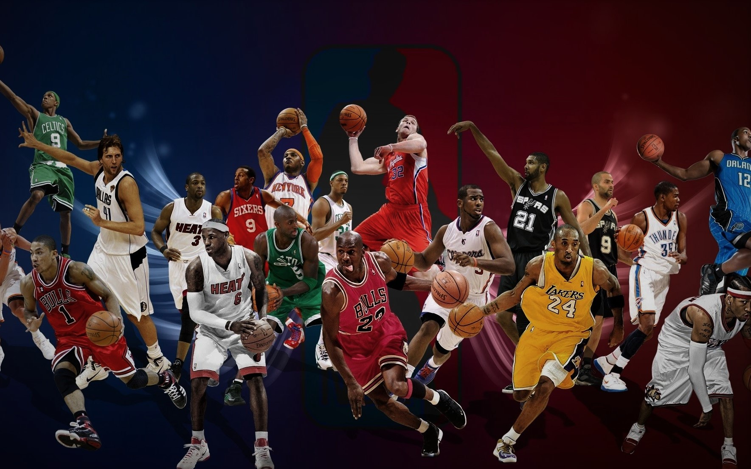
Basketball Stats
Developed by: Corey Karnei, Colby Janecka, Barrett Stricklin, Chloe Bryant, and Harry Schneider

Slide 2

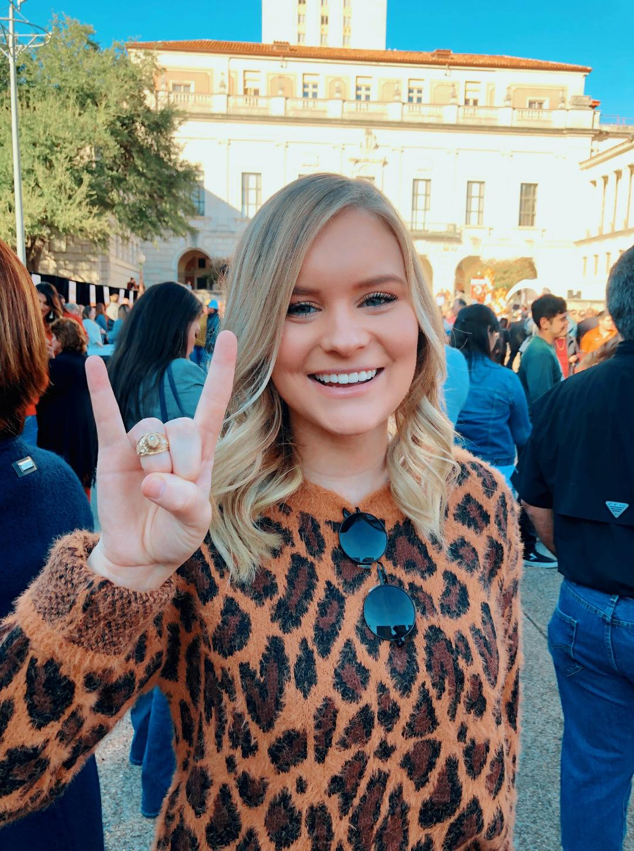



Meet the team:
Corey Chloe Colby Barrett Harry
Karnei Bryant Janecka Stricklin Schneider

Slide 3
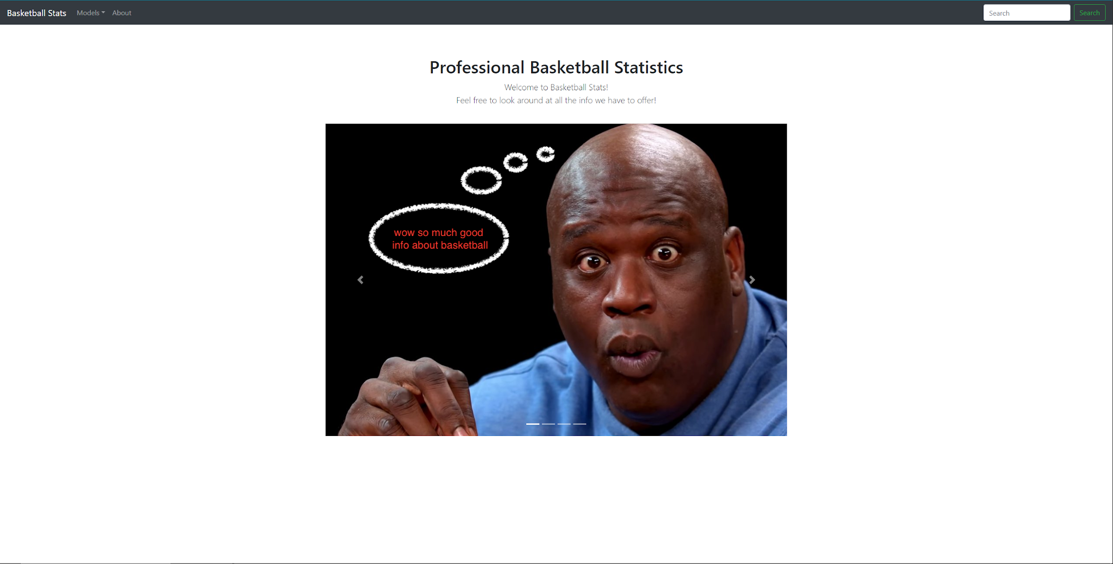
About Our Website:
Summary
Users
Motivation

Slide 4
Walk-through Demonstration:
http://basketballstats-env.eba-mxfc6uzp.us-east-2.elasticbeanstalk.com/

Slide 5
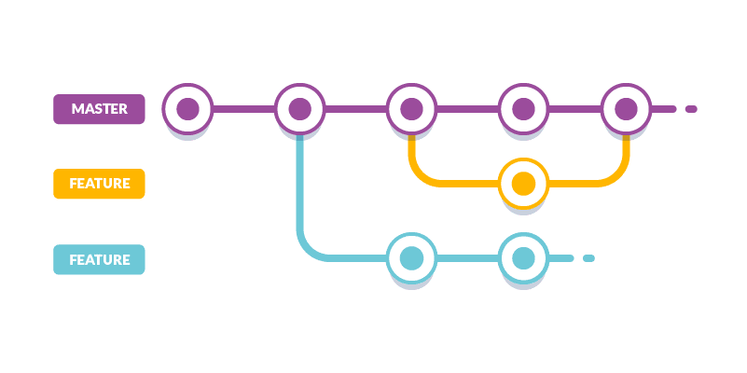
Self Critique: What we did well
Git Workflow
Pair Programming
Issue resolution
Vision for end result

Slide 6
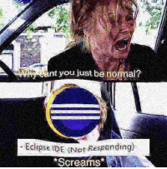
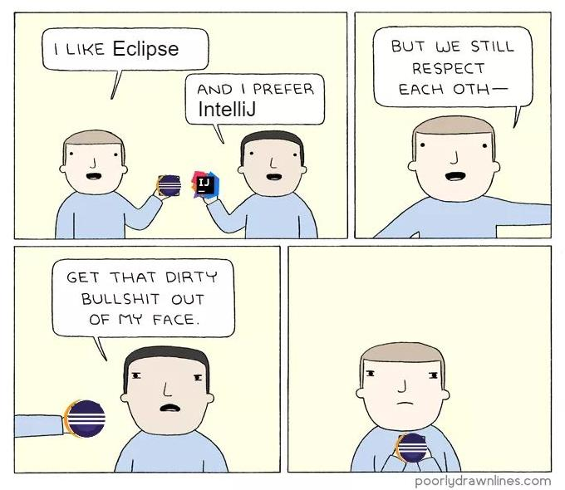
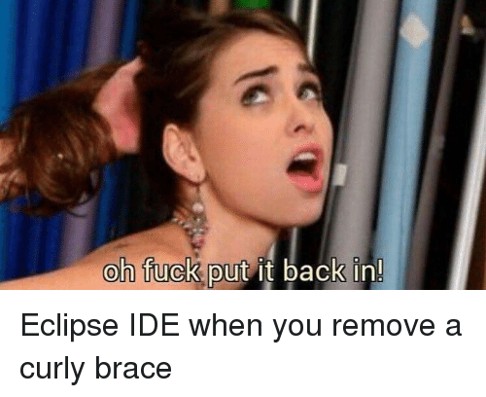
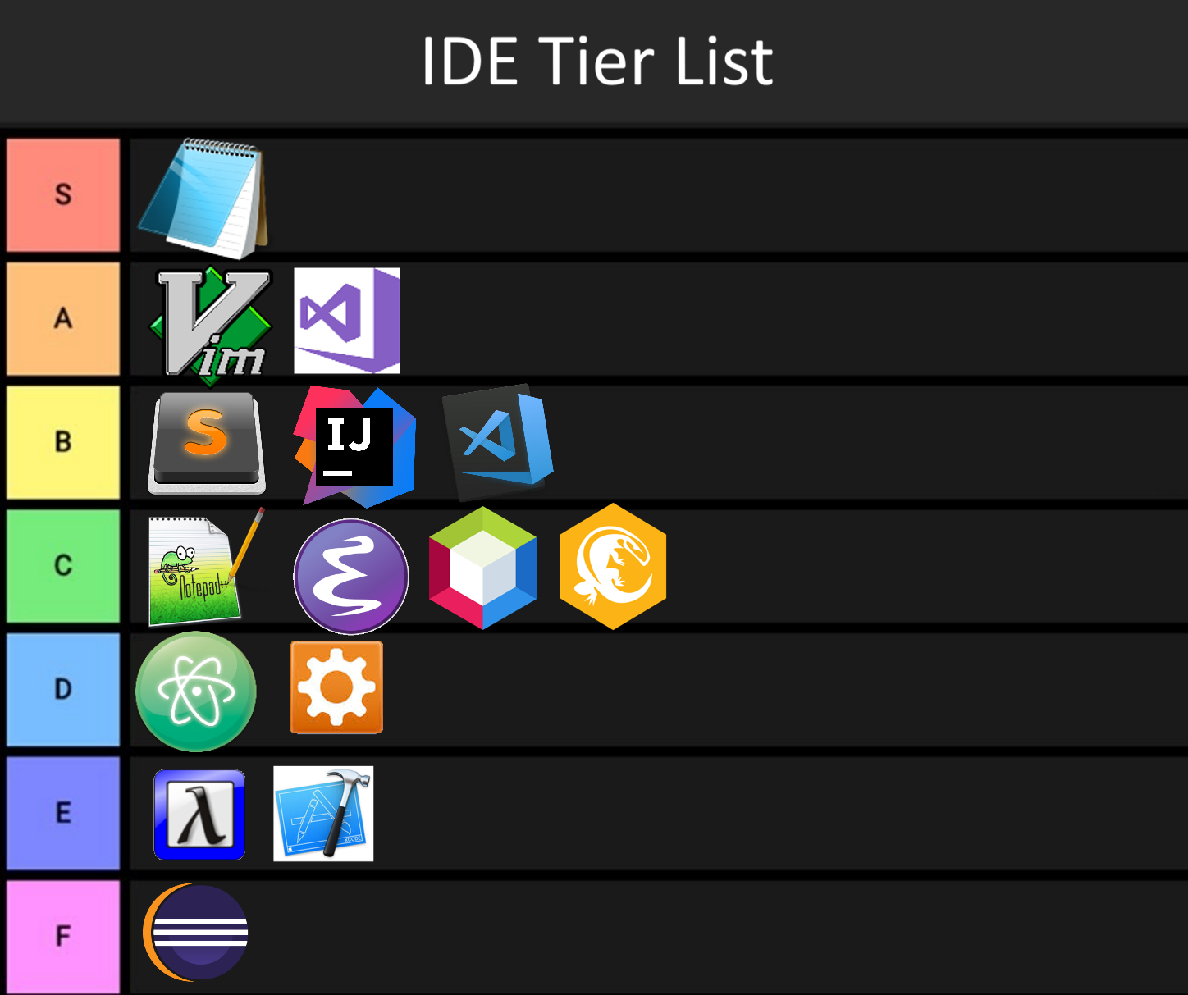
Self Critique: What we could have done better
Having a standard for variable names
Eclipse IDE
Adding design patterns late
Meeting times

Slide 7

Self Critique: What we learned
Design patterns should have been considered before code was written
Honesty among group members relating to abilities and strengths
(COVID-19) Shifting everything to online was harder than expected
Less popular frameworks and technologies are tough to troubleshoot

Slide 8
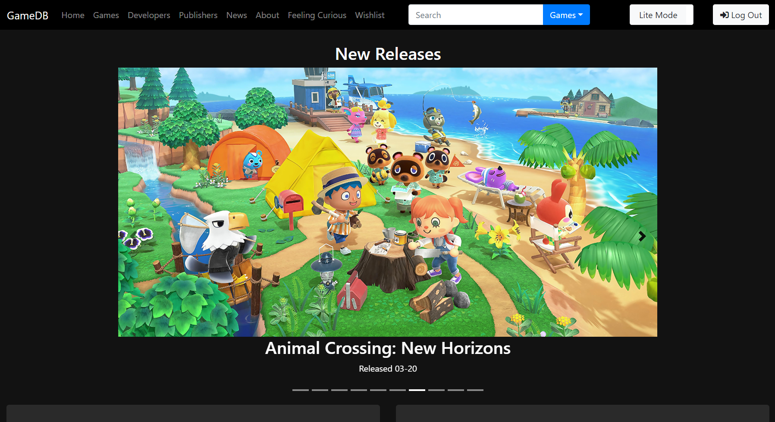
Developer Critique:
What they did well:

Slide 9
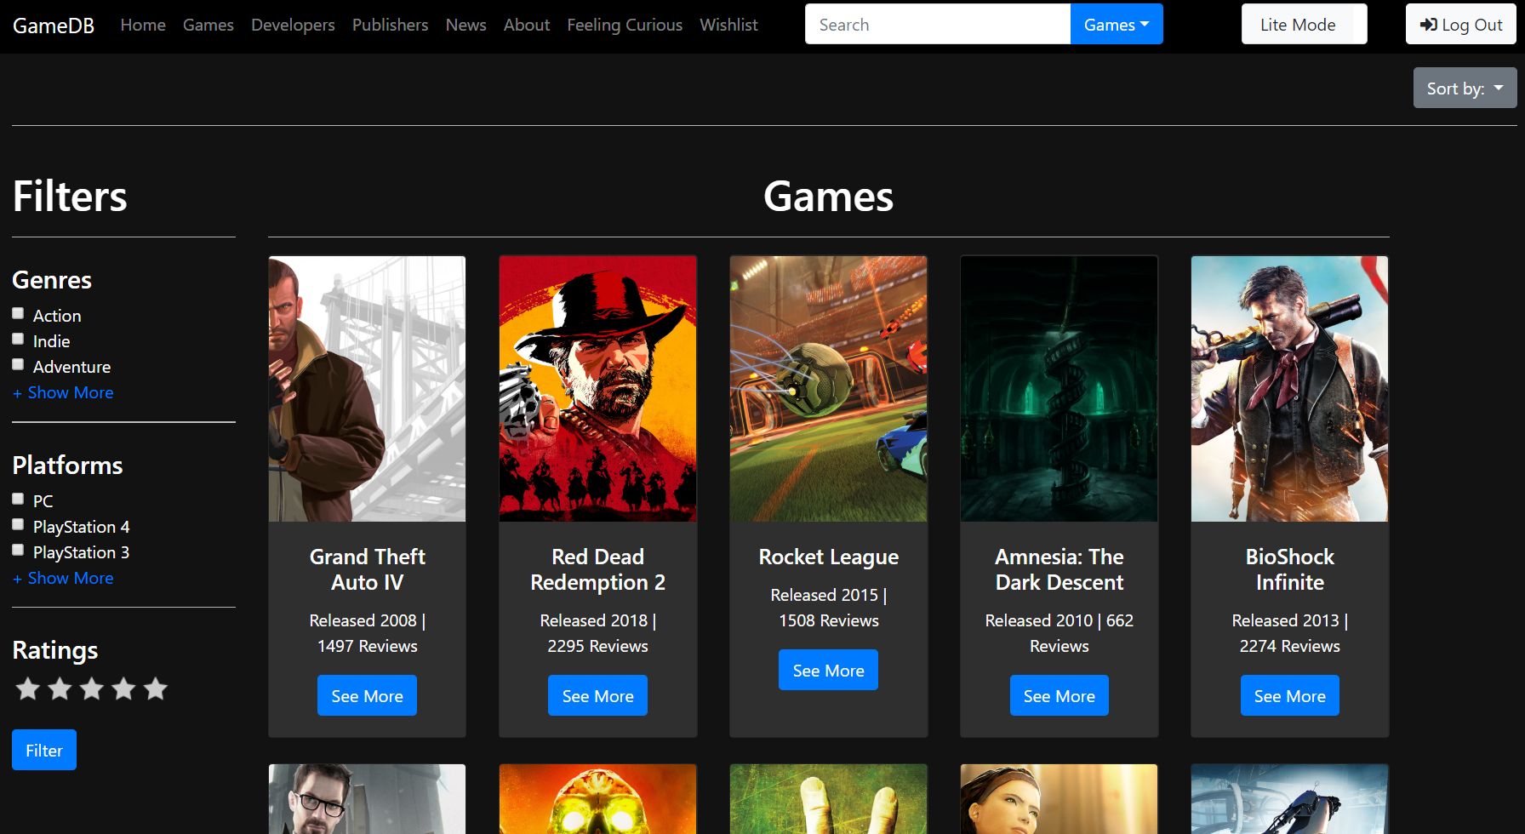
Developer Critique:
What they did well:

Slide 10
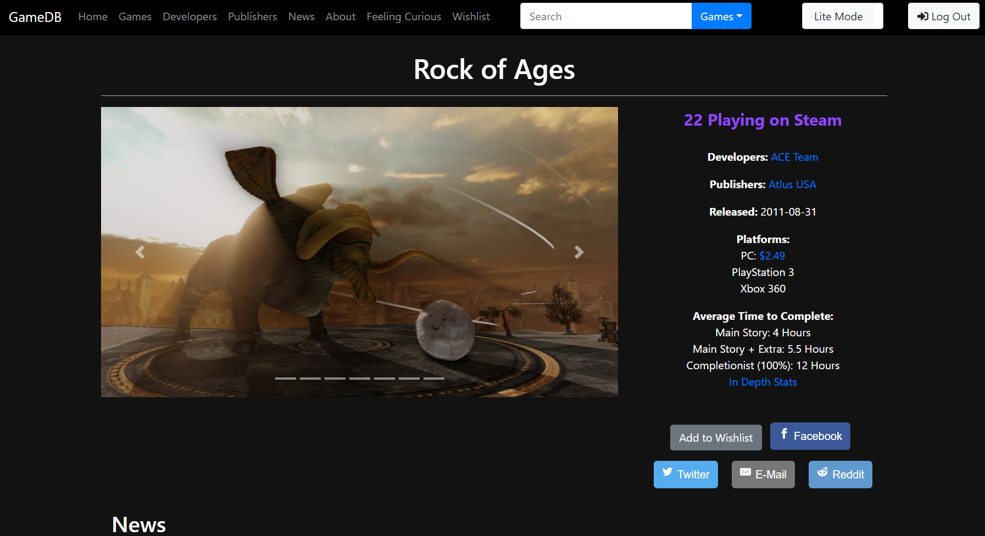
Developer Critique:
What we learned:

Slide 11
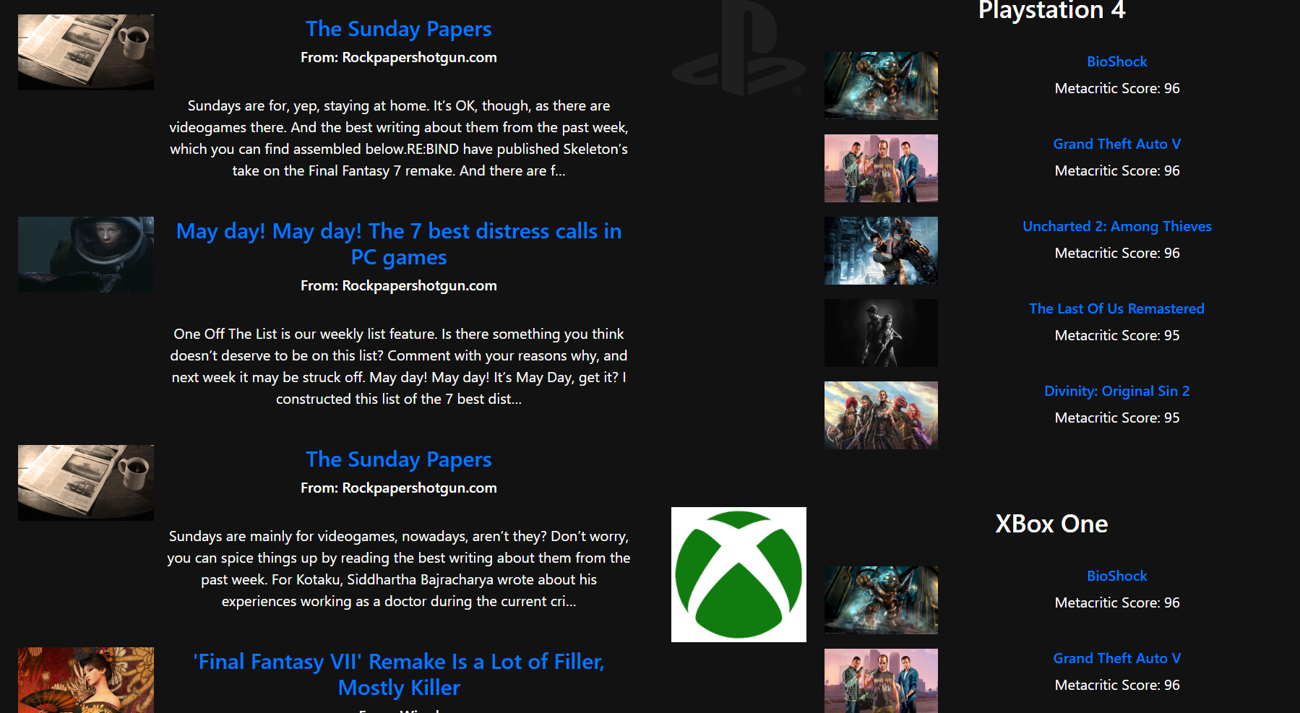
Developer Critique:
What they could do better on:

Slide 12
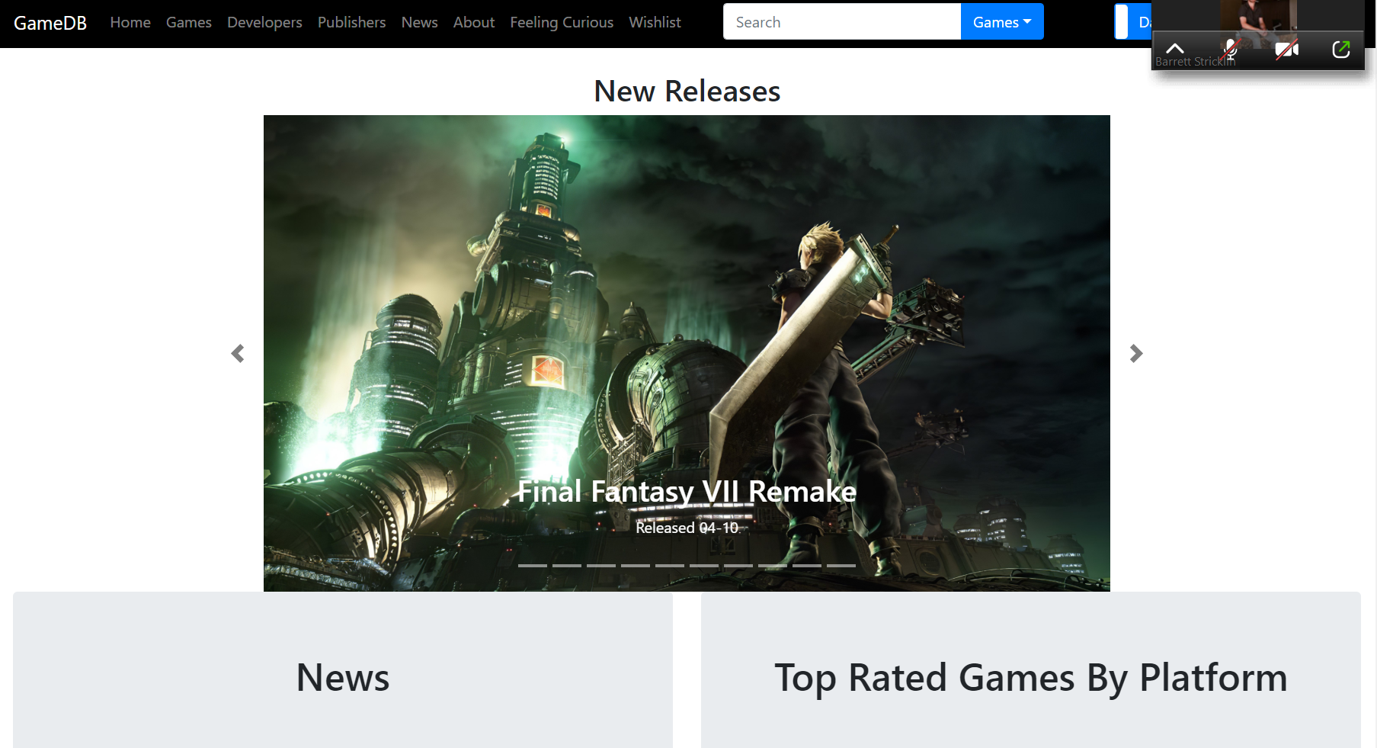
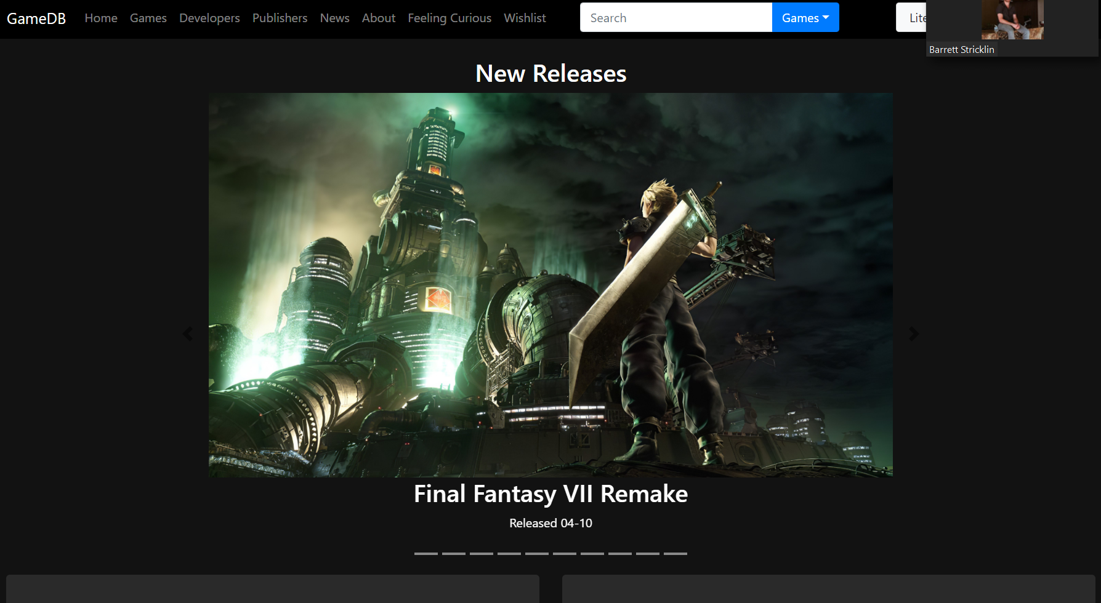
Developer Critique:
What puzzled us:

